Slide 1
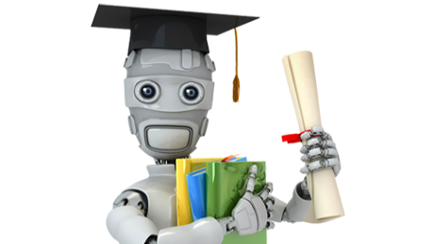
Teaching machines to learn
keshav joshi
kmjoshi@gatech.edu
Courtesy: https://www.coursera.org/learn/machine-learning

Slide 2
Why?
Amazon, Baidu, Google and others spent US$20-40B on AI in 2016
R&D + acquisitions
What for:
Tech
Financial Services
Health care
Power grid
Logistics
Manufacturing
Retail
Education
http://www.mckinsey.com/business-functions/mckinsey-analytics/our-insights/how-artificial-intelligence-can-deliver-real-value-to-companies

Slide 3
Successes
Computer Vision - Image/Pattern Recognition
Facial recognition
Autonomous robots/driving vehicles
Early disease detection
Content/Retail/Ad strategy (recommendation engines)
Netflix/Facebook/Amazon etc.
Malware/Fraud/Spam detection
Speech Recognition
Natural Language Processing
Natural Sciences

Slide 4
Visible successes
Chat (chatbots pass basic turing test)
Beat recreational games (chess/go/poker)
Paint (style-transfer)

Slide 5
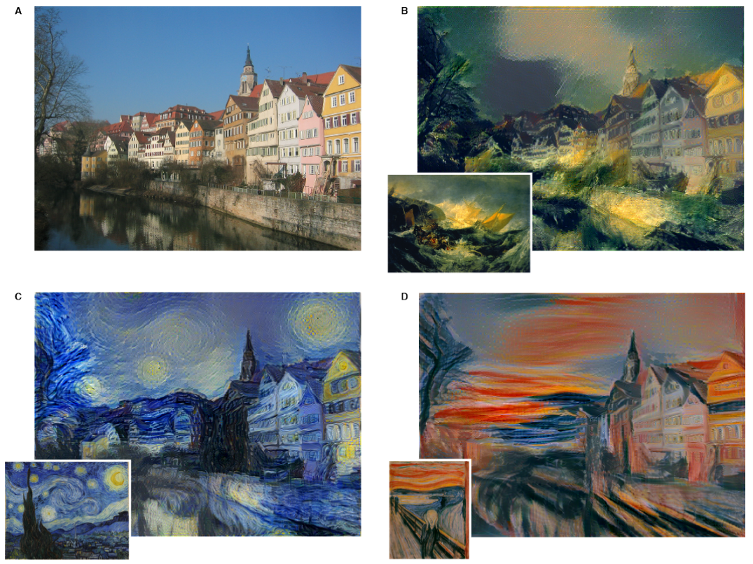
Visible successes
Chat (chatbots pass basic turing test)
Beat recreational games (chess/go/poker)
Paint (style-transfer)
https://research.googleblog.com/2016/10/supercharging-style-transfer.html

Slide 6
Visible successes
Chat (chatbots pass basic turing test)
Beat recreational games (chess/go/poker)
Paint (style-transfer)
https://research.googleblog.com/2016/10/supercharging-style-transfer.html

Slide 7
Machine Learning (basics)
Supervised Learning
have a lot of data with labels
learn on all the data to predict these labels for new data
eg. image classification of a dog
Unsupervised Learning
have a lot of data with no labels
learn something useful about the data
eg. market segmentation of user clicks on website
Reinforcement Learning
make rational decisions based on a utility function
eg. any process with many steps, where you know the target
To consider: false positives & true negatives

Slide 8
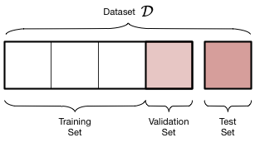
Machine Learning (how-to)
Get a lot of data: eg. GPL power outage
Depends on lots of features: day, time, duration, weather, location etc.
Ask a question: eg. how long is each outage?
classification or regression?
Split data into:
training set (experience)
validation set (explore)
test set (exam)
Train-experience
Tweak hyperparameters on validation set-explore
Test performance
https://am207.github.io/2017/wiki/validation.html

Slide 9
rolling down that hill
Gradient descent:
update model: roll down hill (hyper-hill)
https://alykhantejani.github.io/a-brief-introduction-to-gradient-descent/

Slide 10

Machine Learning (methods)
Decision Trees
Split on features
To consider (hyperparameters):
How to split?
How many nodes? How deep?
Don’t Overfit
Use a random forest: lots of trees
https://www.analyticsvidhya.com/blog/2016/04/complete-tutorial-tree-based-modeling-scratch-in-python/

Slide 11
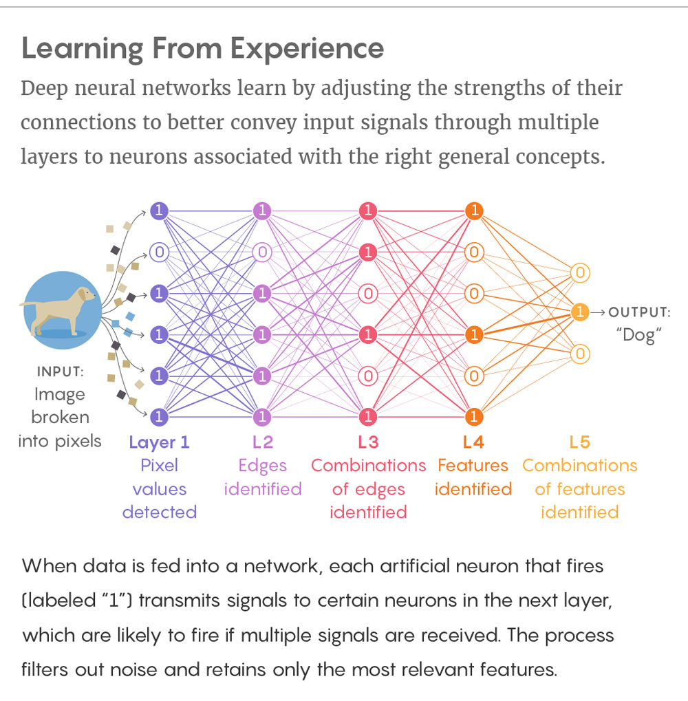
Machine Learning (methods)
Logistic Regression:
like linear regression but for classification tasks
output probability of belonging to class
Support Vector Machines
divides classes based on vectors (lines or hyper-lines)
Neural Networks (famous)
inspired by biology: composed of neurons
update weights of neurons at each iteration
glorified regression

Slide 12
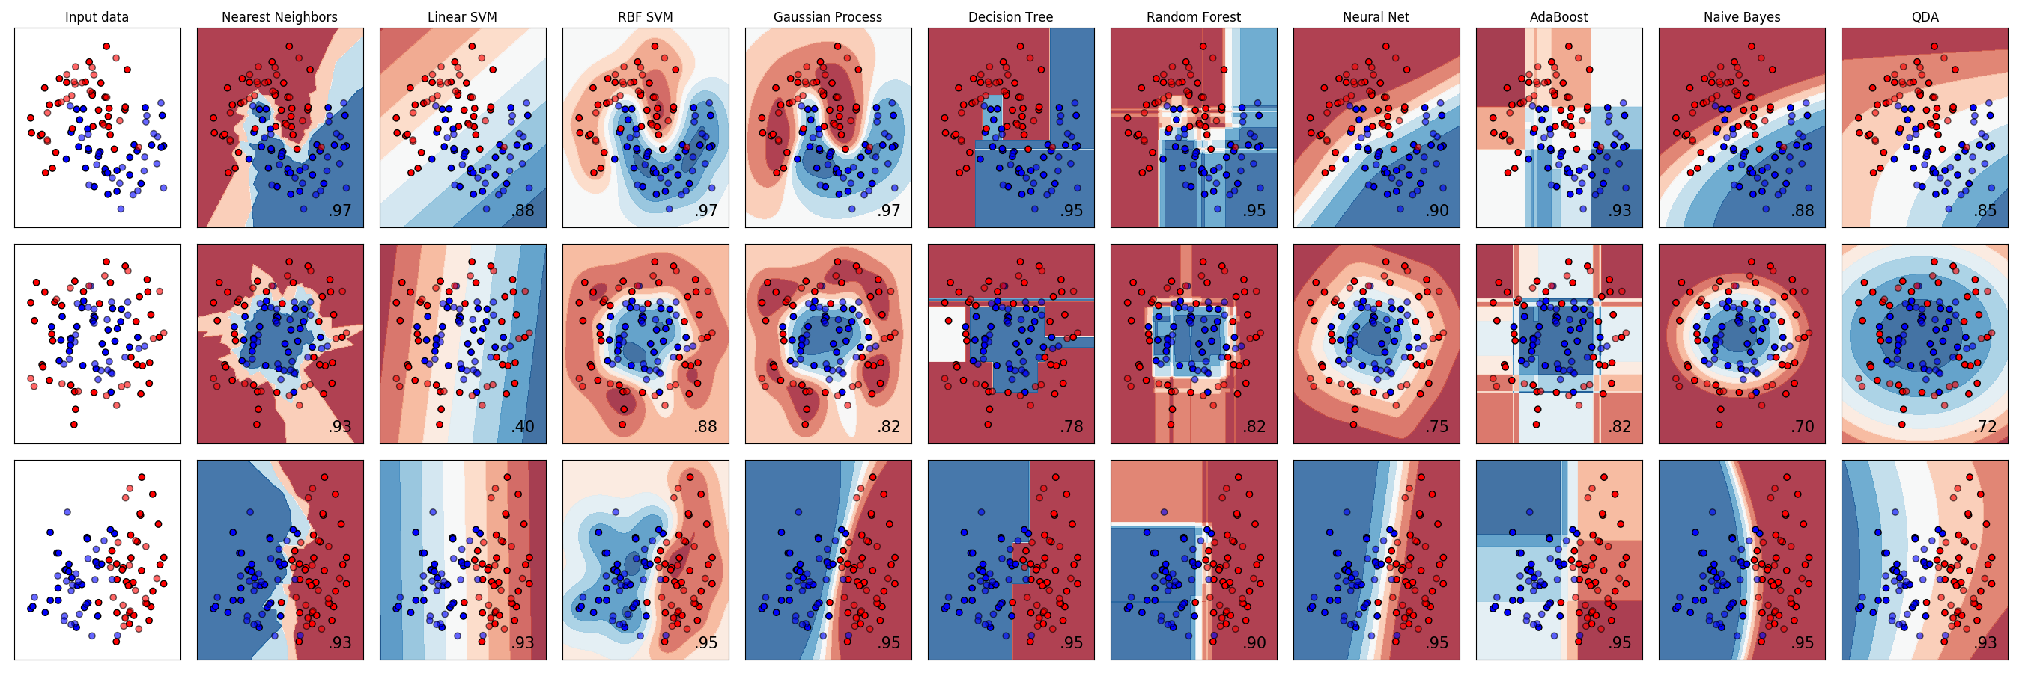
Machine Learning (methods)
http://scikit-learn.org/stable/auto_examples/classification/plot_classifier_comparison.html

Slide 13
How?
eg. deep neural networks:
Lots of hidden layers
First few layers understand larger scale features
Middle layers understand small scale features
Last few layers generalize to the data
Learn then forget
You don’t think about the things you are best at
https://www.quantamagazine.org/new-theory-cracks-open-the-black-box-of-deep-learning-20170921/

Slide 14
AI is RL
Allowing intelligent agents to learn
What is an agent:
Takes input
References from what it has learned
Makes decision (and implements if possible)
Goal: Make agents that always do the right thing (rational)
To consider:
How much to remember?
What is the environment like?
What does the agent want? (Utility function)

Slide 15
Environments
Stuart Russell, Peter Norvig. Artificial Intelligence: A Modern Approach

Slide 16
and it walks!
https://deepmind.com/blog/producing-flexible-behaviours-simulated-environments/

Slide 17
What can you do?
Explore the vast amount of resources on the internet to learn any one of these techniques.
Machine Learning frameworks come in handy open-source packages. (w/ tutorials and benchmarks)
Enjoy the learning!
P.S. Robots won’t take over anytime soon.

